Slide 1

CSF
Assignment (30%)
Cyber Security Fundamentals
Diploma in CSF/IT/DS/IM & CICTP Programme
Year 1 (2022/23), Semester 1.1
Notes:
Left-hand Bar – Replace FSP by your module code and X by the lecture number.
Replace Lecture Title
Replace < Module Name >
Replace Year and Semester if necessary

Slide 2
Overview of Assignment
Cybersecurity issues are becoming a day-to-day struggle for business.
To successfully fight against malicious intent, it’s imperative that companies make cybersecurity awareness, prevention and security best practices a part of their culture.
The goal of your assignment is to create awareness on cyber security attacks.
You are tasked to strengthen security awareness and you need to form teams of 3-4 (max) students to research on one Real World Cyber Attack and produce a lesson on the Attack.

Slide 3
The objective is to create a bite size lesson using PowerPoint.
A bite size lesson is a concise reading materials allowing people even with basic security knowledge to learn from your research finding.
You and your team members will need to research and choose one real world attack published in the media, Internet, books or literatures, and construct a set of self-pace learning materials.
Your assignment deliverable is in a form of PowerPoint slides that your team will need to submit to your team channel. They can be accessed by your peers to learn from your submissions.

Slide 4
Suggested Lesson Structure
Title of Attack, Year or From when to when
Introduction
Introduce what materials will be presented and who are the target audience
Contents
About the Attack
How the Attack took place ?
Damages & Estimated Cost
Security Domains involved (pay attention to this part, check with tutor if not sure)
Action Taken by the Authority & Status
Related Attacks (Cite 1-2 if any. Place a para. if it is unprecedented)
About the Authors
Include information regarding the authors, private emails, contributions and acknowledgement.
Citations
All reference must be cited (using APA standard) appropriately within your slides.

Slide 5
Examples of Real-World Attacks (not exhaustive)
Forex Trader FBS Breaches, 2021
Australian broadcaster Channel Nine Attack, 2021
Capitol One Data Breach, 2019
Weather Channel Ransomware Attack, April 2019
Citrix Password Spraying Attack, 2019
Texas Ransomware Attack, August 2019
GitHub DoS Attack, 2018
….
Choose attack not too far back to 2000, check with your tutor on exception cases (e.g. Stuxnet Attack)

Slide 6
Submission Details

Slide 7
Deliverables
No. | Deliverables | Due Date
1. | Proposed Title, Overview and Content Outline in PowerPoint Slides | Week 11-Check Point
2. | Completed Lesson in PowerPoint Slides | 2359, End of Week 15
3. | Pre-recorded Video Presentation | 2359, End of Week 16
4. | PowerPoint Slides as aid to Video Presentation | 2359, End of Week 16
All Submissions to Your Team’s Channel setup in your class’s team. Your module rept. will create the team channel for each of the team.

Slide 8
Only one copy of each deliverables need to be submitted by the respective team leader.
Please label the file as follows:
CSF-0422-AssLessonP0X-TeamName.pptx
CSF-0422-AssPresentP0X-TeamName.pptx
CSF-0422-AssVideoP0X-TeamName.mpg4
X – stands for 1-16

Slide 9
Sample Lessons from Previous Runs
https://s10228107.wixsite.com/cictp-csf (Nice design, references are not adhered to APA citation standard)
More coming...
Students are advised to observe the copyrights of the above samples. You are also need to notice it is only a set of PowerPoint slide is needed now and not a Wix lesson. No quiz is needed.

Slide 10
Notices

Slide 11
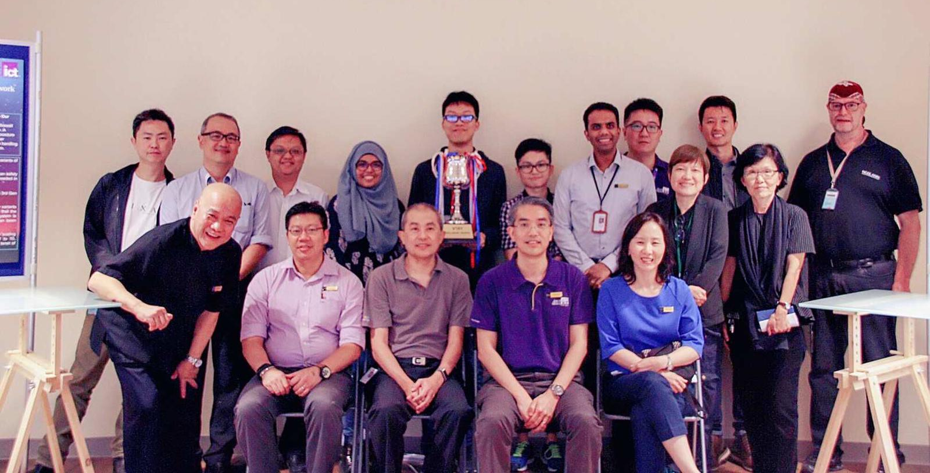
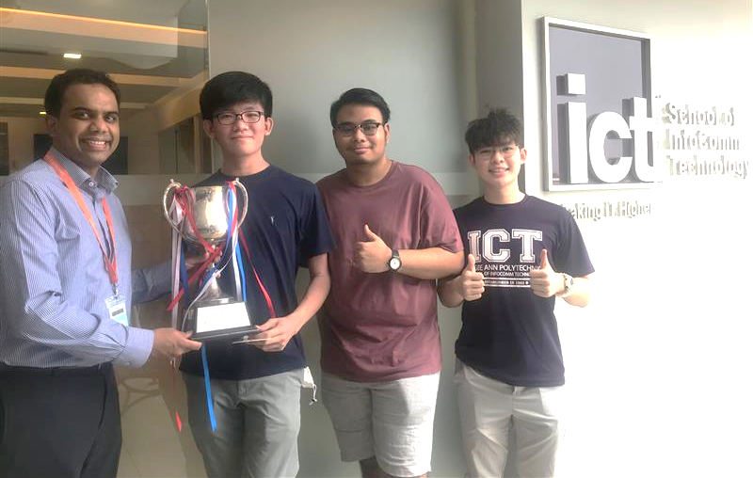
InnovateSecure 2022 (Date: TBA)
Best Assignment will be nominated by your tutor for the above in-housed competition with prizes and challenge trophy.
Good lessons will also be included in an online learning repositories for all to access.
An artifact for your Portfolio.

Slide 12
End

